Slide 1
Presentation on Carbon capturing technology

Slide 2
Problem Identified
Too many motorized equipment in Industries and vehicles are fuel powered hence run-on Petrochemicals which are the number 1 carbon waste emitter. The slow yet impactful exertion of carbon waste into the atmosphere becomes harmful hence a danger to not just our respiratory systems now but also to the fate of humanity as a whole because of the daily depletion of our Ozone layer.
The Ozone layers safety is the reason why most Technology Giants in our modern-day society strive to quickly reduce our carbon footprint on earth

Slide 3
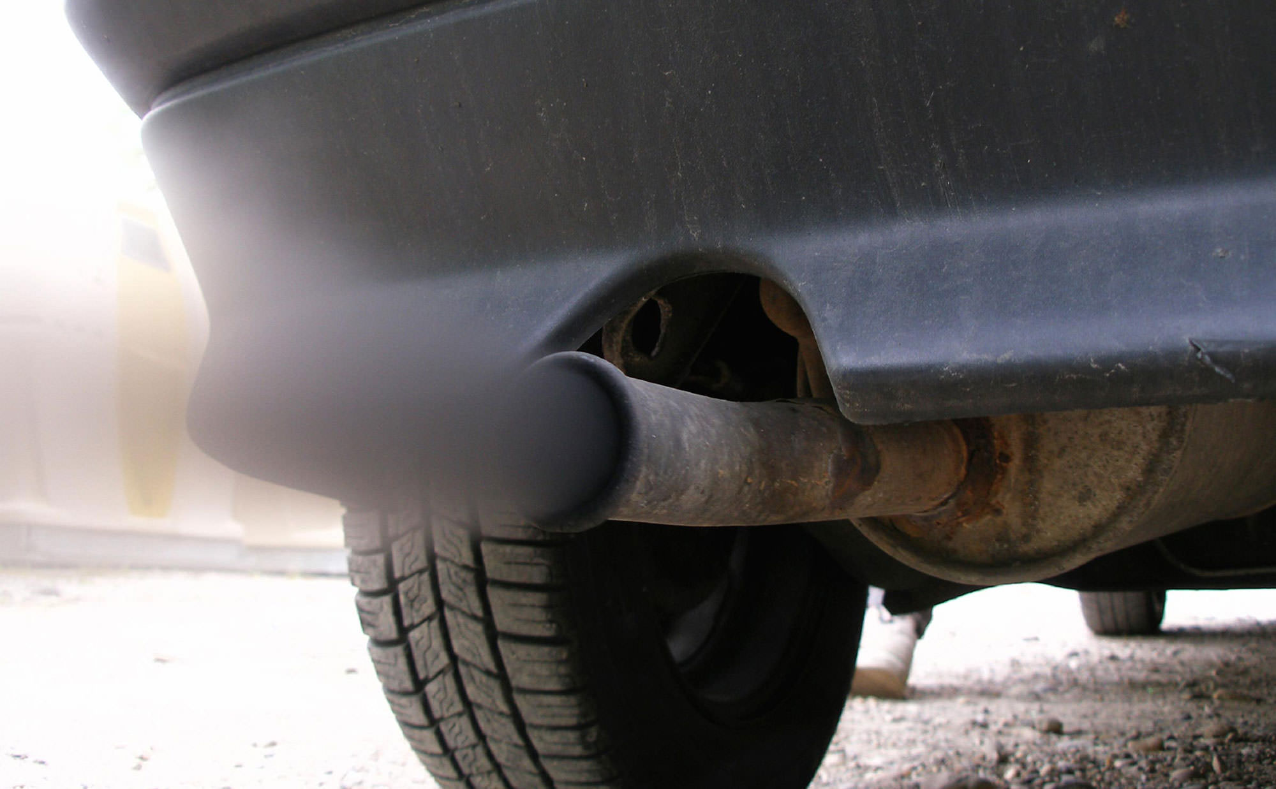
Source to be focused on
Although there are Several sources of carbon emission, I aim at reaching the end goal one step at a time by focusing on the exhaust pipes of petrol-powered cars.

Slide 4
Potential Solution
Creating a Vacuumed carbon capturing separator for the exhaust pipes of fuel powered automobiles

Slide 5
How it works

Slide 6
Aerogel for heat resistance
Dry ice for further coolness and H20 (7 days)
Add to aero planes (over 100k a year)
Combustion chambers

